Slide 1







BUILD YOUR AI AGENT
12 Jan 2026
1 - 2 pm
10.1.17

Slide 2

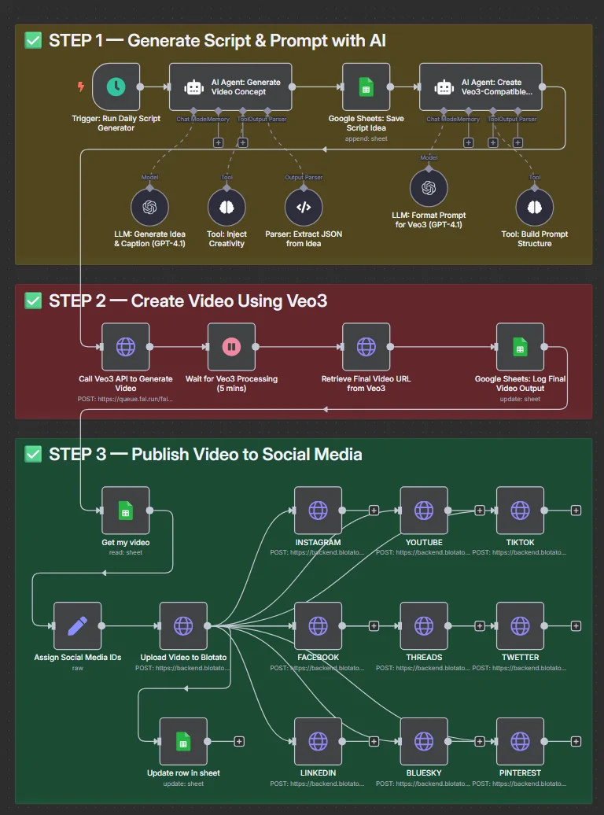
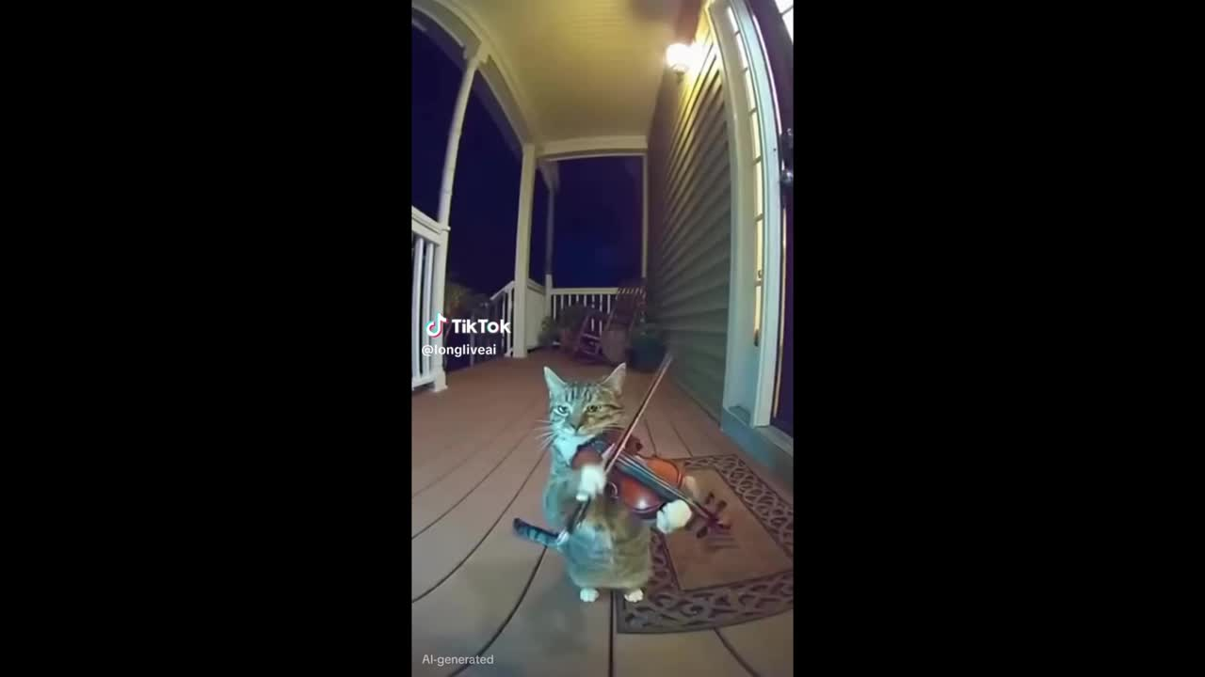




Notes:
https://automategeniushub.com/workflow_items/n8n-generate-auto-post-ai-videos-to-social-media/
https://www.bbc.com/future/article/20240819-why-these-ai-cat-videos-may-be-the-internets-future
https://www.tiktok.com/@longliveai/video/7572588903748734230

Slide 3


AGENDA
What is an AI Agent?
AI Agent? AI Assistants?
Building blocks of AI Agent
How AI Agents look like?
Let’s build!
There is More

Slide 4

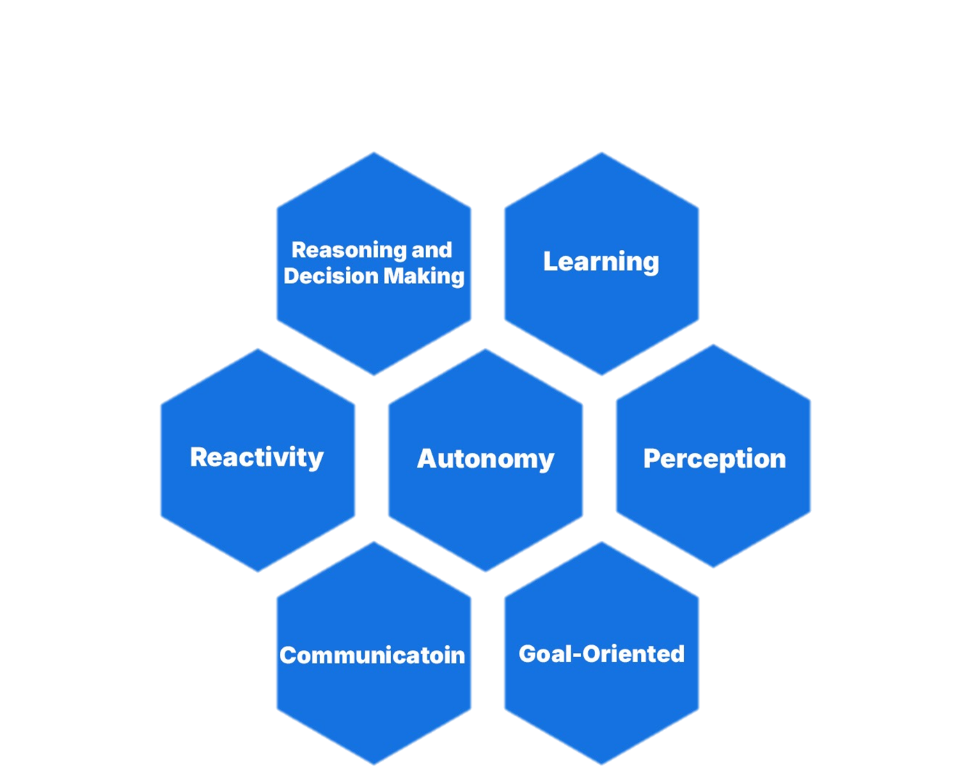






WHAT IS AN AI AGENT?
Notes:
Autonomy: AI virtual agents can carry out tasks independently, without the need for constant human guidance or input.
Perception: These agents perceive and interpret their surroundings using various sensors, such as cameras and microphones, to understand their environment.
Reactivity: AI agents evaluate environmental changes and respond appropriately to fulfil their objectives.
Reasoning and Decision-Making: Equipped with advanced algorithms, AI agents analyse data, apply reasoning techniques, and make informed decisions to accomplish their goals.
Learning: Through machine learning, deep learning, and reinforcement learning techniques, AI agents can adapt, improve, and enhance their performance over time.
Communication: AI agents can interact with humans and other agents using various communication methods, including natural language understanding, speech recognition, and text-based messaging.
Goal-Orientated: Designed to achieve specific objectives, AI agents can follow predefined goals or adapt and learn new goals based on their interactions with the environment.
(Deepak Wadhwani, 2025)

Slide 5

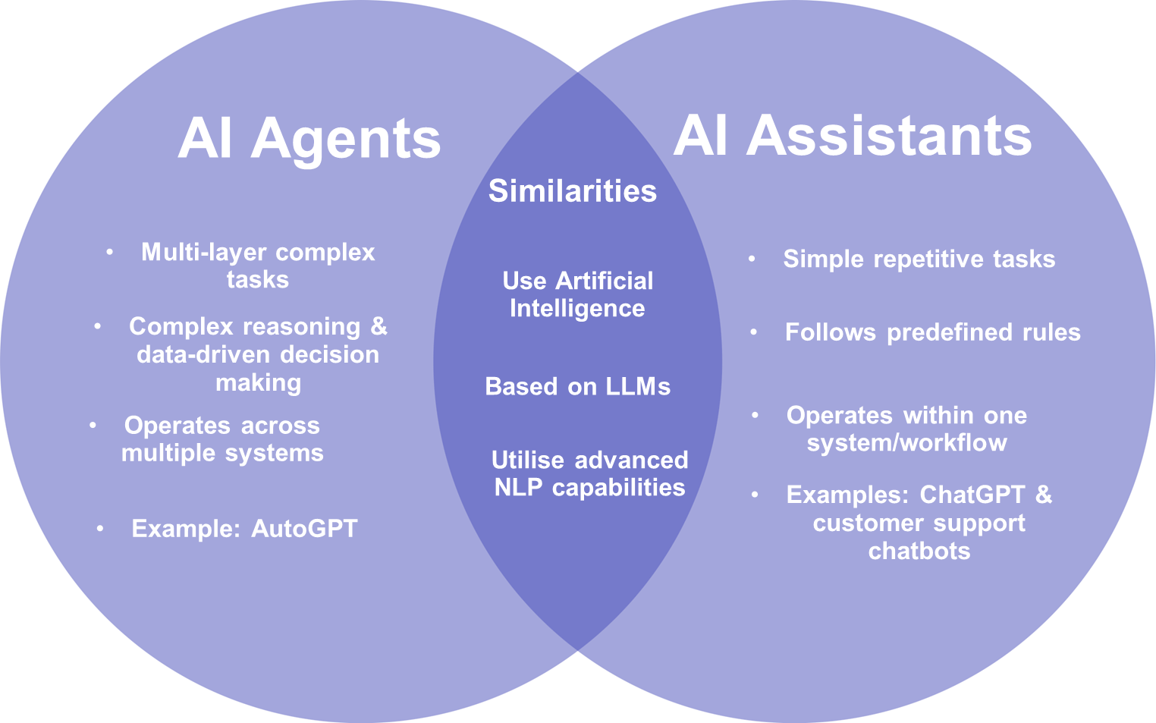



AI AGENTS ?
AI ASSISTANTS ?

Slide 6



AI AGENT BUILDING BLOCKS
NODES
AI agents are built using connected nodes

Slide 7
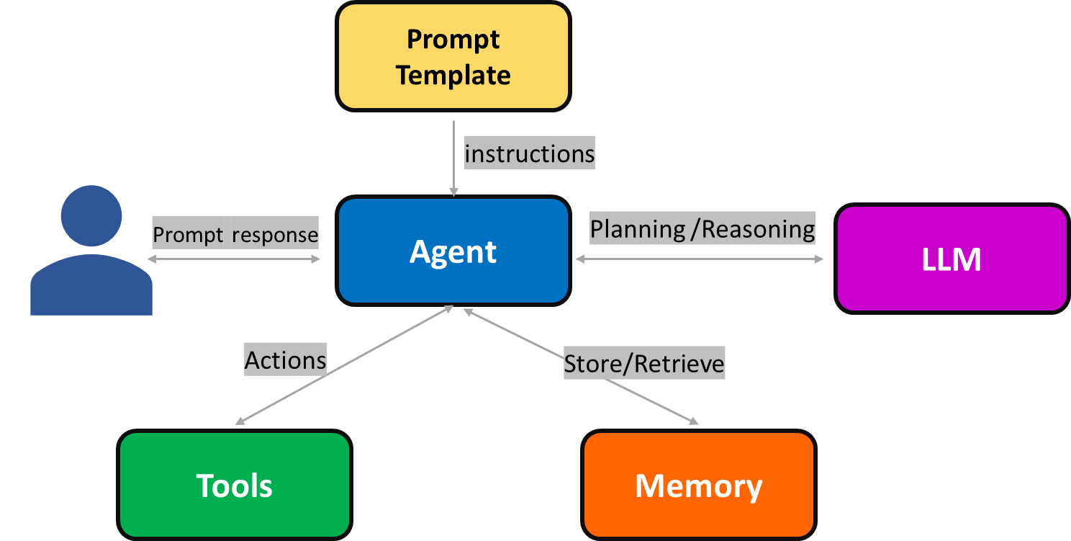
WHAT DO AI AGENTS LOOK LIKE?
Chat-Based AI Agent
Notes:
This is a chat based agent.
1. Difference between chat based ai agent and ai chat box like chat gbt.
2. It has a memory. Stores information and dosent need to be said over and over again.

Slide 8
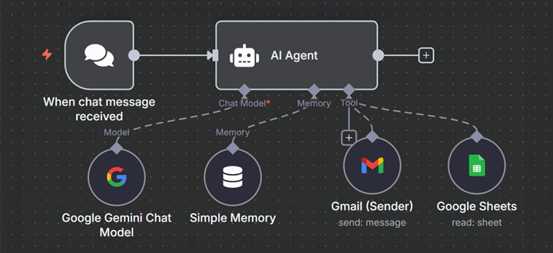
AI AGENT EXAMPLE
Notes:
(RACE Labs, 2025)

Slide 9
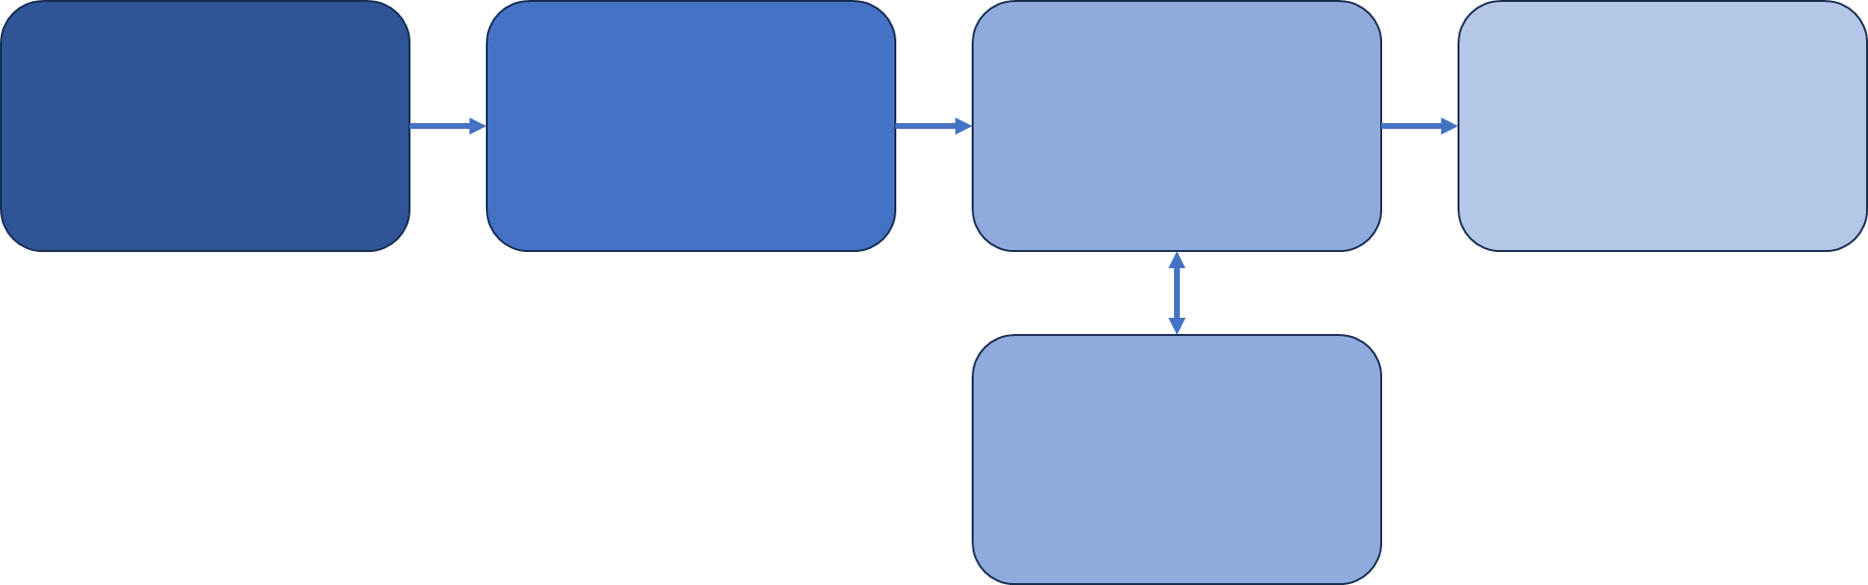



LET’S BUILD!
STUDY PLANER
User Input
Prompt
Template
The LLM
Output
Your Courses and Deadlines
Your Study Plan
How Do You Want the Schedule
Memory

Slide 10



Slide 11
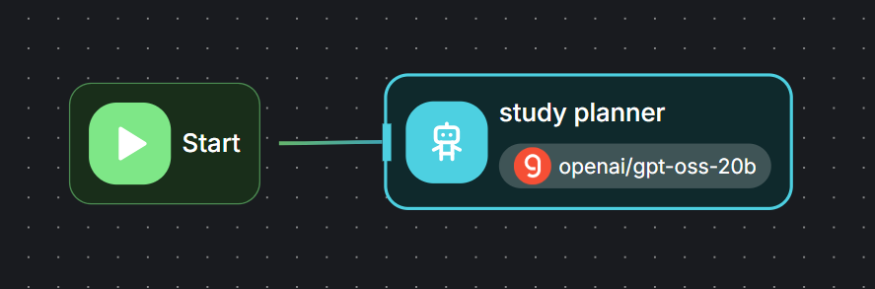





THERE IS MORE!
AgentFlow
Multi-Agents
WHY STOP HERE?
Google Calendar
Web Search
To Do List
Send Email
Excel Sheet

Slide 12

KEEP GOING WITH THE WORK
MENTORS ARE HERE TO HELP
Remember!!
Behind every smart agent is at least one confused human

Slide 13

THANK YOU!
We appreciate your time and attention.

